Slide 1

Modeling and Analyzing the Effects of Delays - Consensus of Networks of Multi-Agent Systems
Myrielle Allen-Prince
MS Candidate
Mechanical Engineering

Slide 2
Overview
Introduction
Consensus Problem
Applications
Objective
Time Delay
Methods
Modeling
Effects
Network Topologies
Convergence Speed
Stability
Sensitivity
Experiment
Results
Summary
Future Work

Slide 3
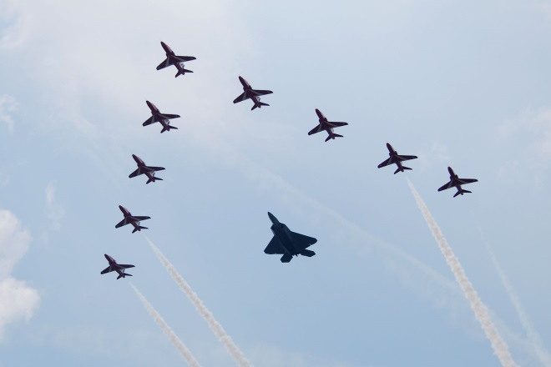
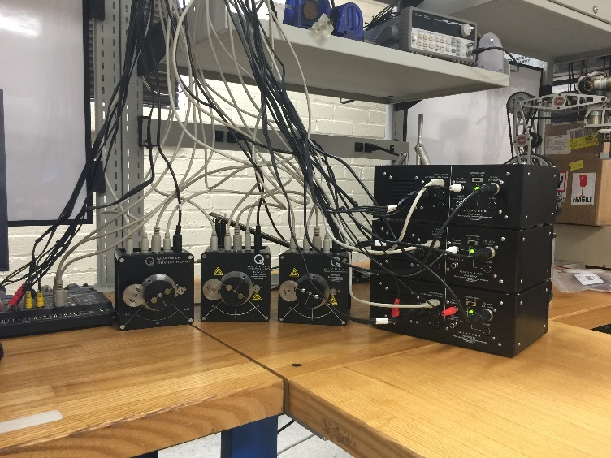
Introduction
Networks of Multi-agent systems
Better performance than single agents
Less setbacks or failures
Improvement in outcomes of certain tasks
[Crutchfield Team,2015]
Notes:
Networks of multi-agent systems are expected to communicate to perform specific tasks or make decisions. Unlike a single agent, MAS can perform multiple complex tasks in less time and encountering less setbacks or task failures. MAS can improve security, search and rescues, environmental monitoring, and much more.

Slide 4

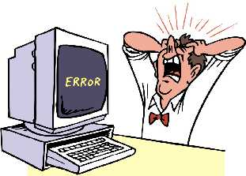
Consensus Problem
Decision/ Task agreement
Communication
Issues
Delayed information
Time Delay
Control Algorithm
Coordinated and cooperative control
Notes:
The consensus problem consists of making the individual agents within a network come to an agreement on a decision/task. The difficulty of the consensus problem lies within the uncertainties presented by the environment and each individual agent’s capabilities. Networked systems are prone to failures due to uncertainties such as disturbances, nonlinearity, information/signal loss, delay, etc. This research focuses on the consensus problem and developing a new and more efficient way to ensure these systems are coming to an agreement in the presence of delay.
The strength of communication between these systems are important especially since they will be communicating wirelessly. Wireless communication is not reliable due to the possibility of signal fading, interference, attenuation, intermittent connectivity , link breakage, etc. All of these can lead to delayed communication between agents. Delay in communication is expected but with how long cannot be predicted. These effects can cause instability and unpredictable behavior

Slide 5
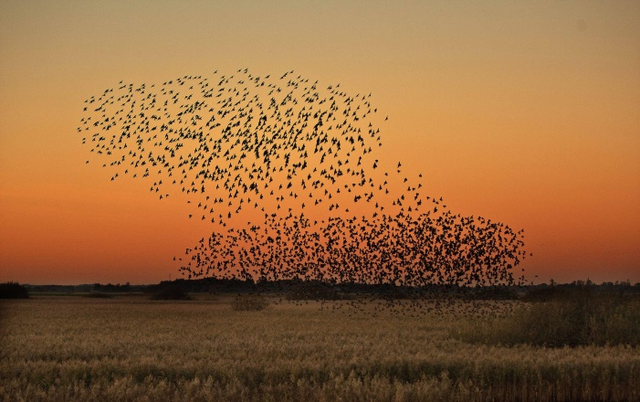
Applications
Formation Control
Leader and follower
Attitude Alignment
Satellite formation
Rendezvous
Sensor detection
Flocking
Aerial robots
[Sun Yi, 2015]
[Tobias Niebuhr, 2014]
Notes:
Formation control usually consist of a leader and one or more followers. These followers highly depend on the leader to achieve its goal
Attitude alignment is mainly applied in satellite formation where the satellites are expected to form a cluster close enough to accurately control attitude and separation
Rendezvous consists of multiple agents moving with respect to anothers location without communication but through sensors
Flocking conisist of multiple aerial robots performing a task and formation mimics the behavior of migrating birds or a school of fish
All of these applications requires multiple agents to coordinate and come to an agreement
follower architectures
are known to have poor disturbance rejection properties (see,
e.g., [11]). Additionally, a leader–follower architecture depends
heavily on the leader for achieving its goal, and over-reliance
on a single vehicle in the formation may be undesirable,
especially in adversarial environments. The second approach
is the “virtual leader” approach [12], [6], in which vehicles in
the formation jointly synthesize a single, possibly fictitious,
leader vehicle whose trajectory acts as a leader for the group.
This approach avoids the problems with disturbance rejection
inherent in the leader–follower approach, but at the expense
of high communication and computation capabilities needed to
synthesize the virtual leader and communicate its position in
time to support real-time control of other vehicles.

Slide 6
Objective
Analyze the stability of delayed systems
Analyze the sensitivity and convergence speeds w.r.t delay vs topology
Experiment in real-time

Slide 7
Methods for handling delays
Padè approximation
Psuedo-delay
Smith predictor
Bifurcation analysis
Runge-Kutta
Nyquist Theorem
Lyapunov method
Notes:
Upper and lower bound for delay
Lyapunov-Krasovskii
Lyapunov-Razumikhin
BA- stability boundaries
SP-turns DE’s to delay free equations- eliminates the ability to directly analyze the delay
Pade-shortens repeating fraction for better approximation of char eq of delay

Slide 8
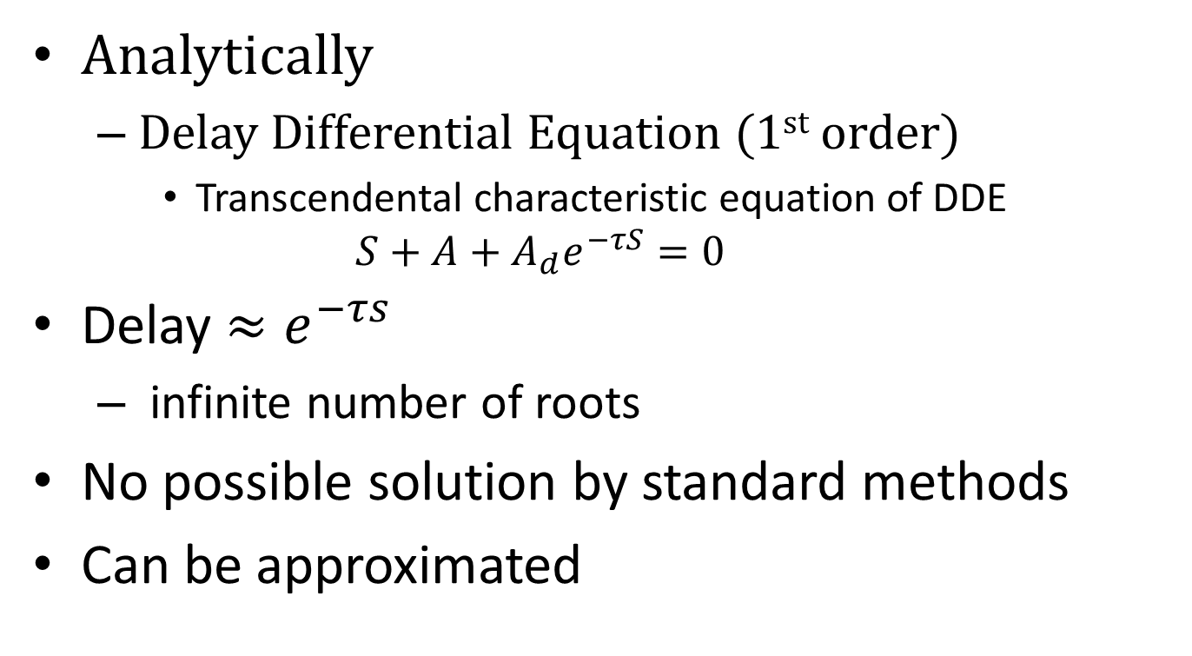
Modeling Delay
Analytically
Delay Differential Equation (1st order)
Transcendental characteristic equation of DDE
$$S+A+A_{d}e^{−τS}=0$$
Delay $≈e^{−τs}$
infinite number of roots
No possible solution by standard methods
Can be approximated
Notes:
The ability to identify time-delay becomes challenging when taking an analytical approach. Delay can be represented by $e^{−τs}$, which has an infinite spectrum. This is a problem when modeling a delayed system with delay differential equations (DDEs) meaning the delay term provides the equation with an infinite number of roots. Analytically modeling the delay will provide a better approach in synchronization. It presents a more effective way to analyze the stability and other characteristics of the system.

Slide 9
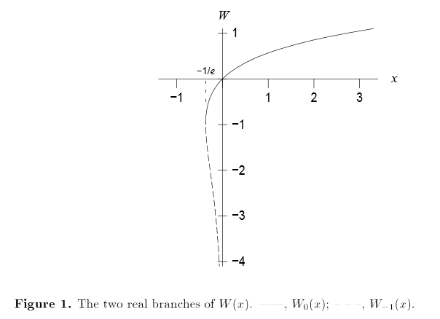
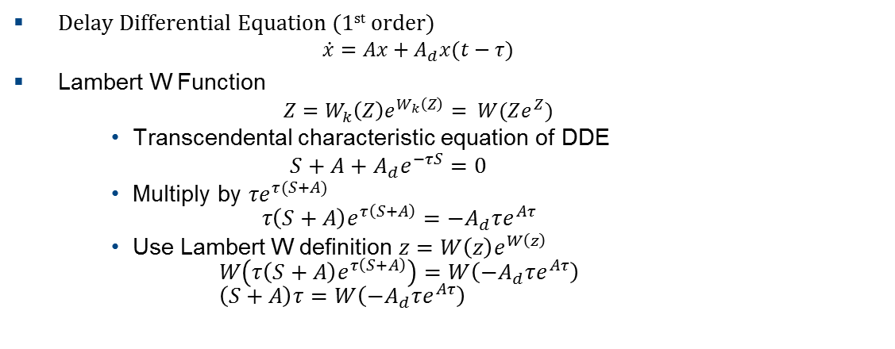
Lambert W Function
Delay Differential Equation (1st order)
$$\dot{x}=Ax+A_{d}x(t−τ)$$
Lambert W Function
$$Z=W_{k}\left(Z\right)e^{W_{k}\left(Z\right)}= W(Ze^{Z})$$
Transcendental characteristic equation of DDE
$$S+A+A_{d}e^{−τS}=0$$
Multiply by $τe^{τ(S+A)}$ $τ\left(S+A\right)e^{τ\left(S+A\right)}=−A_{d}τe^{Aτ}$
Use Lambert W definition $z=W\left(z\right)e^{W\left(z\right)}$ $W\left(τ\left(S+A\right)e^{τ\left(S+A\right)}\right)=W\left(−A_{d}τe^{Aτ}\right)$ $\left(S+A\right)τ=W\left(−A_{d}τe^{Aτ}\right)$
[Sean Stewart, 2006]
Asl, F.M., and Ulsoy, A.G., ”Analysis of a System of Linear Delay Differential Equations,” ASME J. Dynamic Systems, Measurement and Control, Vol. 125, No.2, pp 215-223, 2003
Notes:
These branches correspond to the infinite number of solutions the W function can provide. The principal branch is $W_{0}(z)$ which, as stated by [16] is the only required branch to determine stability in the case of infinite roots.
W represents any complex number and the branches correspond to the roots of the system
If z is greater than -1/e the values of the w0 is real
If less than, the values are complex

Slide 10
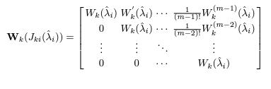
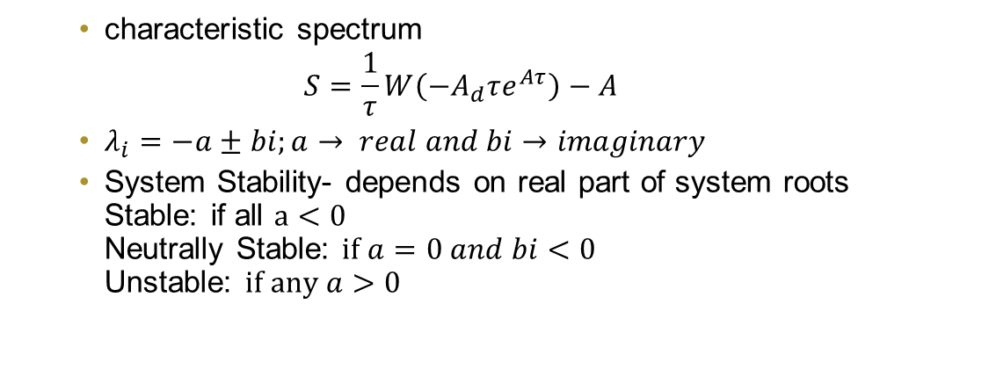
Analyzing Stability
characteristic spectrum
$$S=\frac{1}{τ}W\left(−A_{d}τe^{Aτ}\right)−A$$
$λ_{i}=−a±bi;a→ real and bi→imaginary$
System Stability- depends on real part of system roots Stable: if all $a<0$ Neutrally Stable: $if a=0 and bi<0$ Unstable: $if any a>0$
Jordan Form
Sun Yi, P. Nelson and A. Ulsoy. Analysis and Control Using the Lambert W Function Time Delay System
Notes:
Before solving for the roots of S, the Jordan form of $−A_{d}τ$ is found to handle the repeated eigenvalues. Next $W\left(J(−A_{d}τ) \right)$is evaluated and the off-diagonal values are the derivatives of $W\left(J_{ik}\left(−A_{d}τ\right) \right)$, where ik represents the off-diagonal value in the Jordan matrix. Finally, a new matrix, W(H), is found by the eigenvalue decomposition $\left(eq.3.9\right)$; V is the eigenvector matrix of $J(−A_{d}τ)$. S can now be found by replacing$\left(eq.3.8\right)$ with $\left(eq.3.10\right)$. The eigenvalues of S are used to analyze the system; these values can be seen in the complex plane (s-plane) in Figure 3.3.

Slide 11
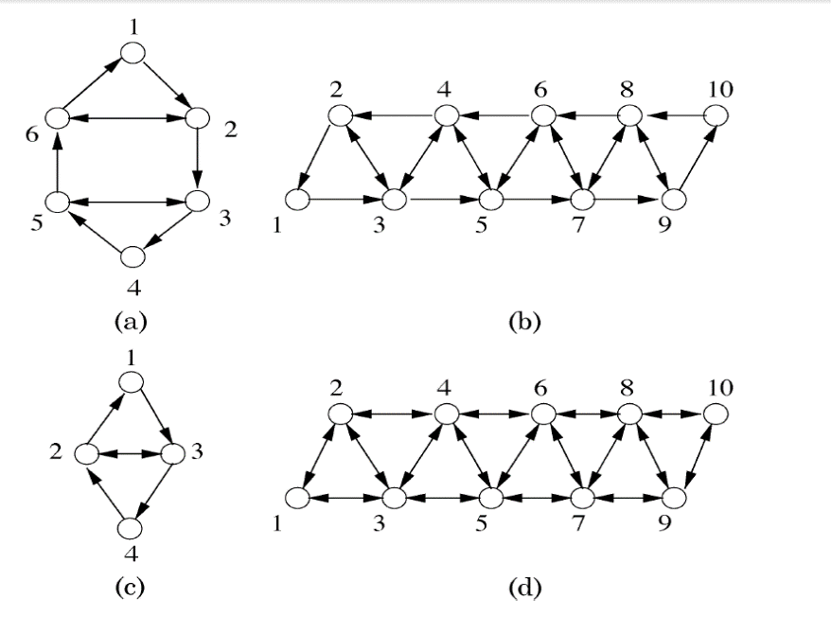
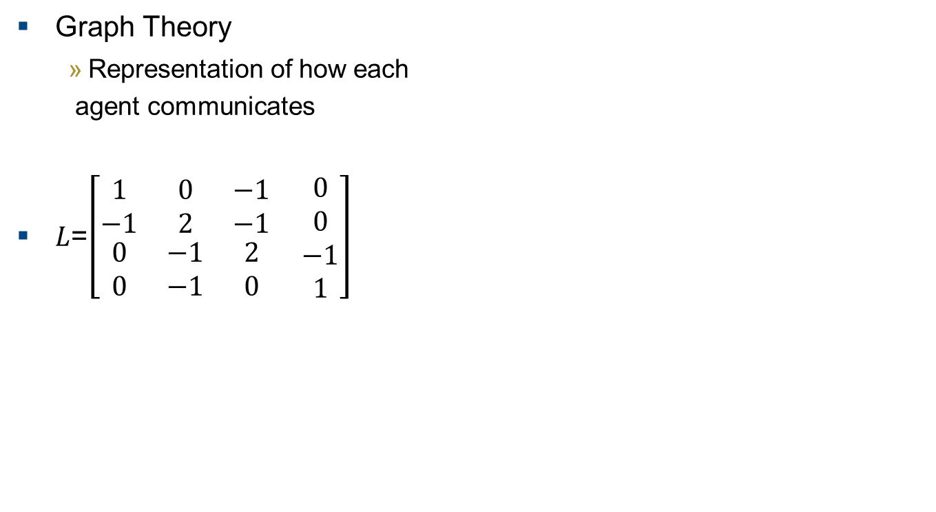

Approach
Graph Theory
Representation of how each
agent communicates
$L$=$\left[\begin{matrix}1 & 0 & −1 \\ −1 & 2 & −1 \\ \begin{aligned}0 \\ 0\end{aligned} & \begin{aligned}−1 \\ −1\end{aligned} & \begin{aligned}2 \\ 0\end{aligned}\end{matrix} \begin{aligned}0 \\ 0 \\ −1 \\ 1\end{aligned}\right]$
$$λ_{1}=0; always$$
Notes:
The definition of a laplacian graph is that the each row sums to zero.
Lambda 1 always zero
GL play crucial role in convergence analysis
By algebraic connectivity The second smallest eigenvalue quantifies the speed of convergence
AC mesuare of performance/speed of consensus algorithms
All graphs a strongly connected meaning there ranks is n-1 and eigenvalues have positive real parts

Slide 12
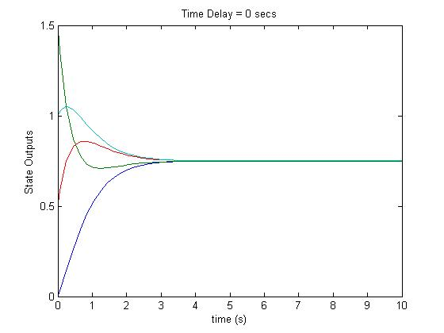
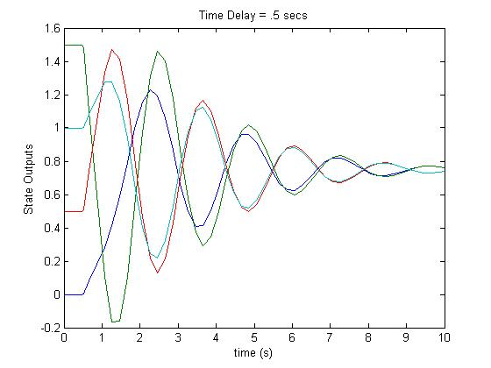
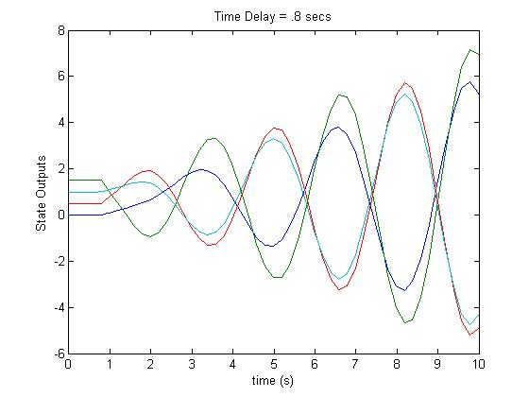
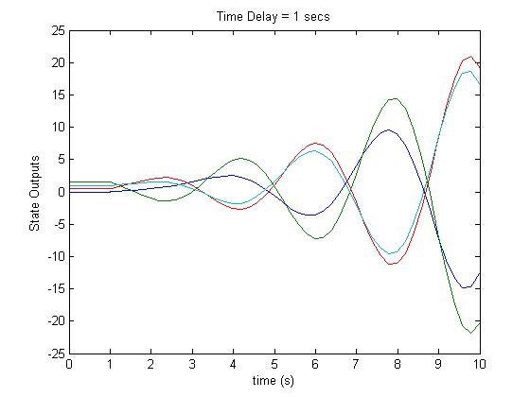
Effects of Time Delay
States become unstable as delay increase

Slide 13
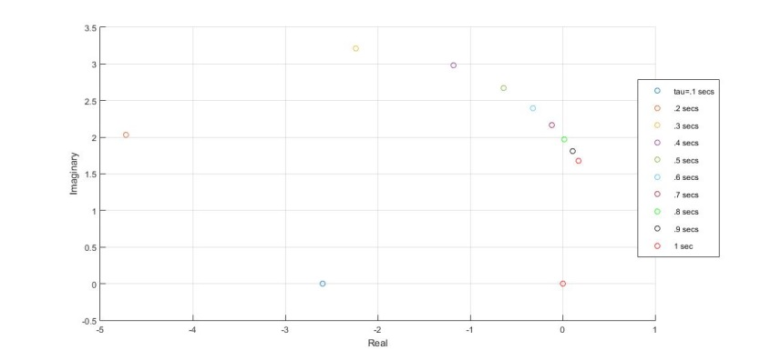
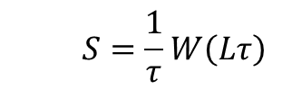
Eigenvalues
$$S=\frac{1}{τ}W\left(Lτ\right)$$
stable
unstable
X
Agrees with simulated results, adding quantity to the stability

Slide 14
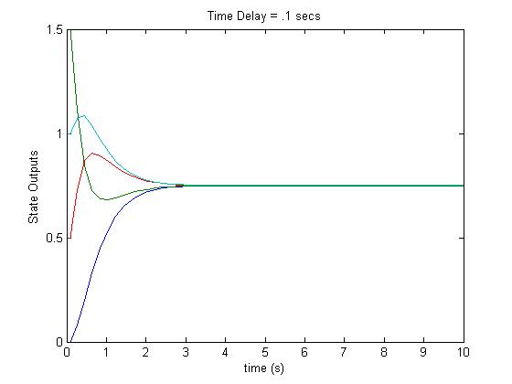
Lambert W
Delay | .1 secs | .5 secs | .8 secs
S_{k} | -0.0000 | -0.0000 + 0.0000i | -0.0000 - 0.0000i
 | -2.5917 + 0.0000i | -0.6363 + 2.6745i | 0.0164 + 1.9739i
 | -2.5917 - 0.0000i | -0.6363 + 2.6745i | 0.0164 + 1.9739i
 | -2.5917 | -0.6363 + 2.6745i | 0.0164 + 1.9739i
Simulations
Accurately quantifies the stability

Slide 15
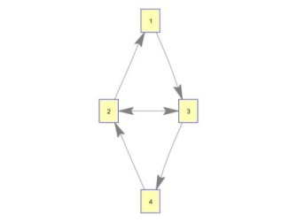
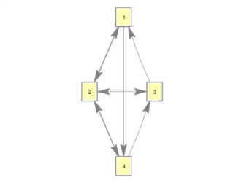
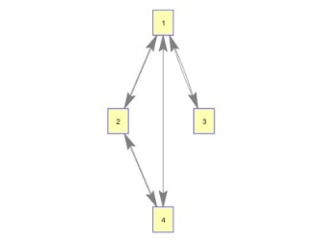
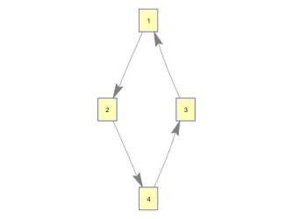
Different Topologies
there are direct effects on the eigenvalues of the Laplacian matrix from changing the topology of a network[Saber, Fax, and Murray 2007]
C
D

Slide 16
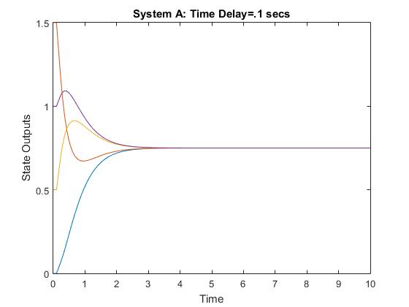
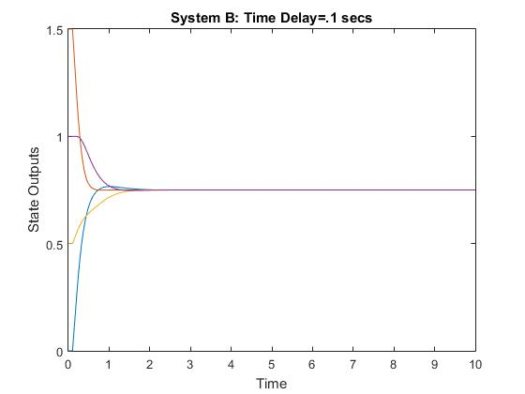
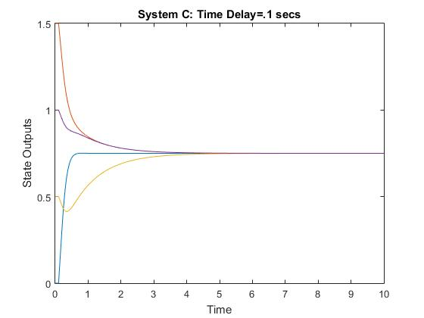
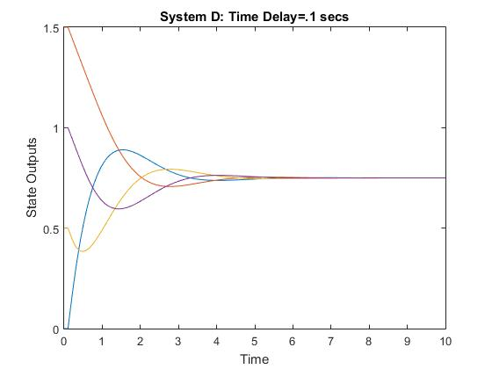
Convergence Speed
B and C faster response

Slide 17
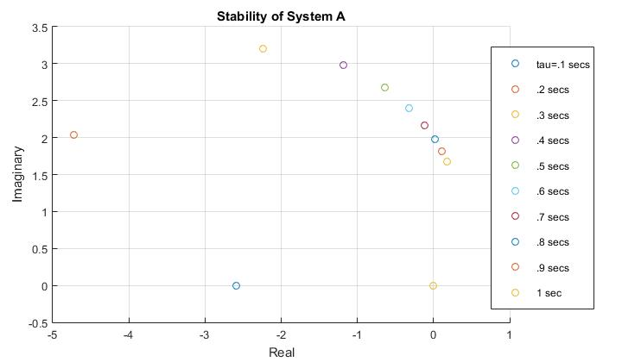
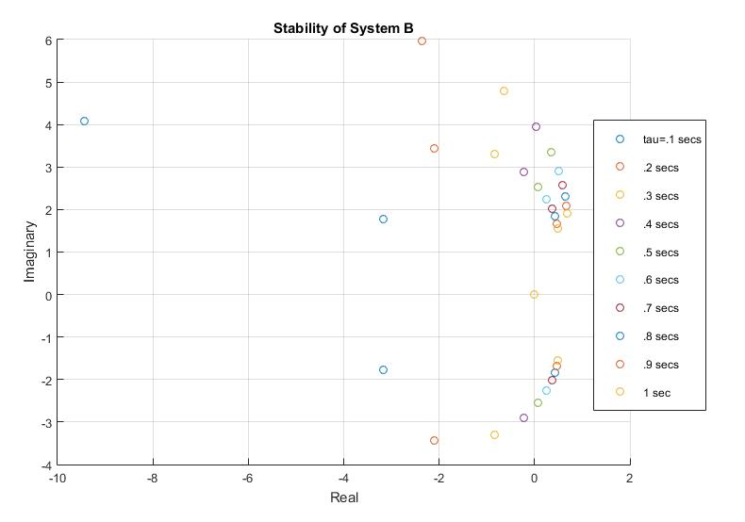
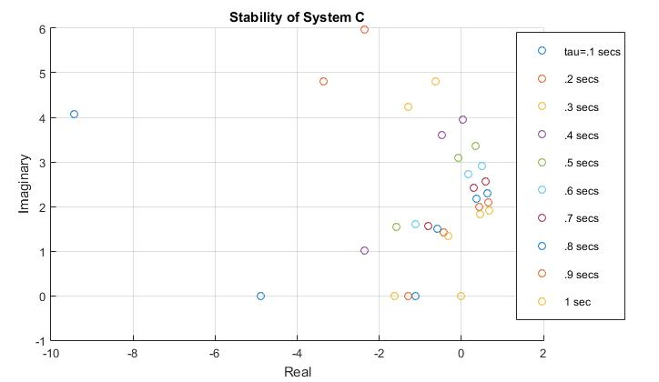
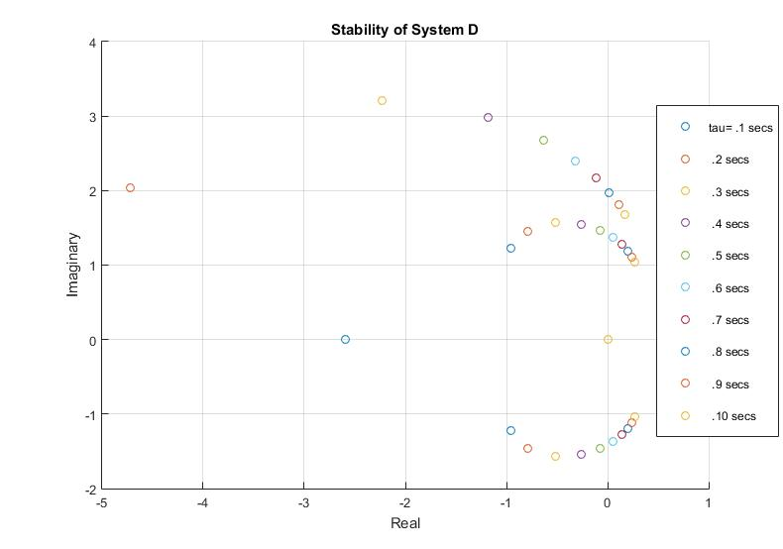
Stability Analysis
A and D more stable
Notes:
system A is the most stable followed by system D. Systems B and C are the least stable with a critical point of .3 seconds, while systems A and D have a critical point at .7 and .5 seconds respectively.

Slide 18
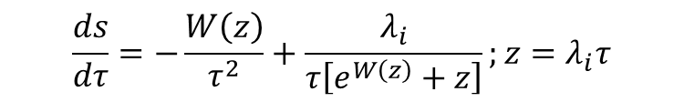
Sensitivity Analysis
$$\frac{ds}{dτ}=−\frac{W\left(z\right)}{τ^{2}}+\frac{λ_{i}}{τ\left[e^{W\left(z\right)}+z\right]};z=λ_{i}τ$$
System A
Delay | .1 | .2 | .3. | .4 | .5 | .6 | .7 Critical pt.
λ₁ | 0.0000 | 0.0000+0.0000i | 0.0000 + 0.0000i | 0.0000 + 0.0000i | 0.0000 + 0.0000i | -0.0000 + 0.0000i | -0.0000 + 0.0000i
λ₂ | -9.0668 | 40.3312 +50.0675i | 15.0194 - 0.3624i | 7.2709 - 3.0772i | 4.0620 - 2.9750i | 2.4821 - 2.5317i | 1.6116 - 2.1114i
λ₃ | -9.0668 | 40.3312 +50.0675i | 15.0194 - 0.3624i | 7.2709 - 3.0772i | 4.0620 - 2.9750i | 2.4821 - 2.5317i | 1.6116 - 2.1114i
λ₄ | -9.0668 | 40.3312 +50.0675i | 15.0194 - 0.3624i | 7.2709 - 3.0772i | 4.0620 - 2.9750i | 2.4821 - 2.5317i | 1.6116 - 2.1114i
System D
Delay | .1 | .2 | .3 | .4 | .5 Critical pt.
λ₁ | -9.0668 + 0.0000i | 40.3312+ 50.0675i | 15.0194 - 0.3624i | 7.2709 - 3.0772i | 4.0620 - 2.9750i
λ₂ | 0.9851 + 2.4647i | 2.4328 + 1.8704i | 2.7848 + 0.3456i | 2.1780 - 0.6068i | 1.5230 - 0.9292i
λ₃ | 0.9851 - 2.4647i | 2.4328 - 1.8704i | 2.7848 - 0.3456i | 2.1780 + 0.6068i | 1.5230 + 0.9292i
λ₄ | 0.0000 + 0.0000i | 0.0000 + 0.0000i | 0.0000 + 0.0000i | -0.0000 + 0.0000i | -0.0000 +0.0000i
Effects of changing topology
Notes:
Performing a sensitivity analysis allows us to see how sensitive the system is to changes in information flow with respect to time delay.
Negative eigenvalues means small change left shift and stable
Positive is small change right shift and unstable

Slide 19
Sensitivity Analysis
System B |  |  |  | System C
Delay | .1 | .2 | .3 Critical pt. | Delay | .1 | .2 | .3 Critical pt.
λ₁ | 0.0000 + 0.0000i | -0.0000 + 0.0000i | 0.0000 + 0.0000i | λ₁ | 0.0000 + 0.0000i | 0.0000 + 0.0000i | 0.0000 + 0.0000i
λ₂ | -5.42 + 17.88i | 17.6204 + 4.0936i | 8.4906 - 3.8467i | λ₂ | -46.91 + 0.0000i | 33.7937 - 0.8153i | 12.0611 - 7.0302i
λ₃ | -5.42 - 17.88i | 17.6204 - 4.0936i | 8.4906 + 3.8467i | λ₃ | -1.41 + 0.0000i | -2.2667 + 0.0000i | -5.2121 +0.0000i
λ₄ | 161.32 + 200.27i | 29.0836 -12.3087i | 9.9286 -10.1267i | λ₄ | 161.32 +200.27i | 29.0836 -12.3087i | 9.9286 -10.1267i
Sensitive to change in topology

Slide 20
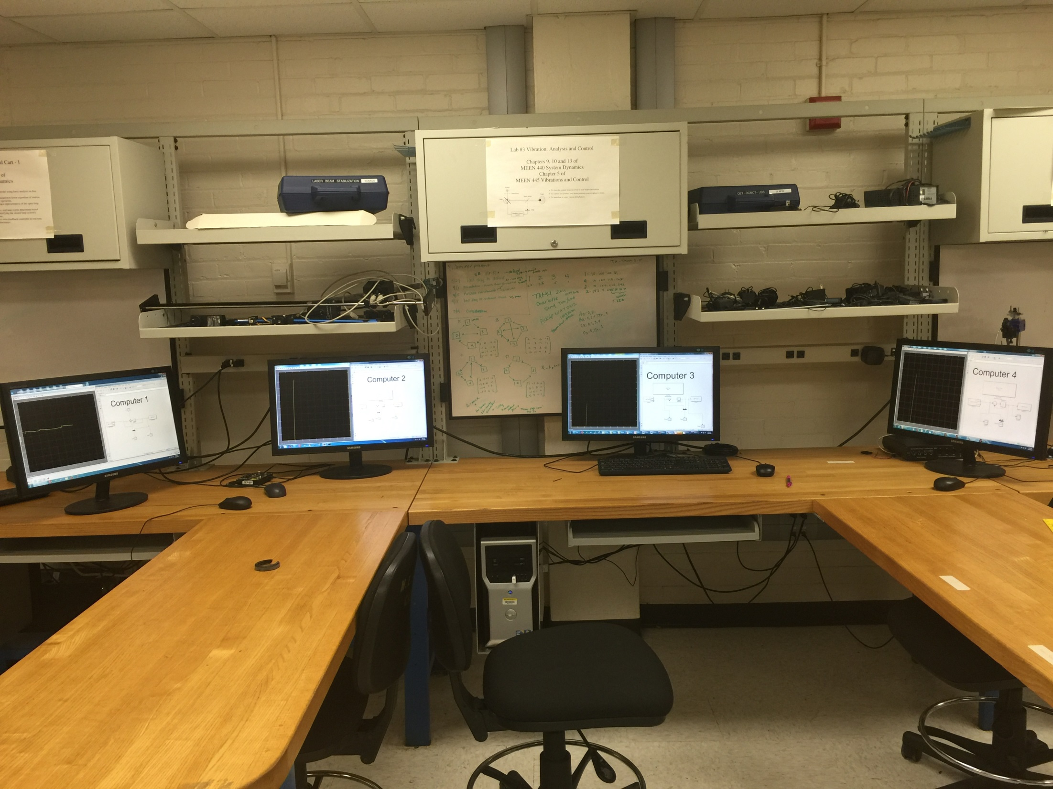
Experiment
Host

Slide 21
Computer Communication
User Datagram Protocol
Transmission Control Protocol
TCP/IP
Connection required
“Handshake”
Flow control
Emails, webpages,…
UDP
Connectionless
Fast
Ignores packet loss
Real-time applications
Notes:
Computers communicate with either a tcp or udp. A transmision control protocol or user datagram protocol.
A tcp requires a connection meaning when comp 1 trsnmits inforamtion to computer 2, 1 must also reiceive conformation of the delivery
Udp will send information no matter without care to whether computer 2 is receiving the information.
Tcp is much slower – because of low control which consists of error checking
Tcp ensures that the order in whichthe packets are sent is the same order it is being received. If a packet is not delievered, the information is resent.
Udp skip the error checking and ignores loss packets allowing for consistent and faster communication
Tcp is mostly used for emails and webpages where a missing data packet can ruin the delievery or display
Udp is used for realt time apps such as games or videos, where missing data only results in delayed image equal to tape skipping
Udp was used because fast and consistent information flow is required and a missing data packet will not disable the systems overall performance or terminate the communication. Also a handshake is not possible since the systems are not started simultaneously

Slide 22
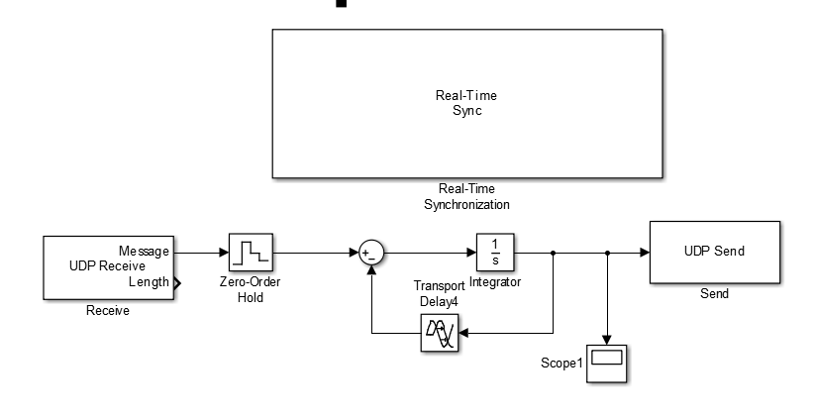
Simulink
Notes:
ZOH holds sample value for sample interval reconstructing the signal from digital to analog, converting from discrete to continuous time signal

Slide 23
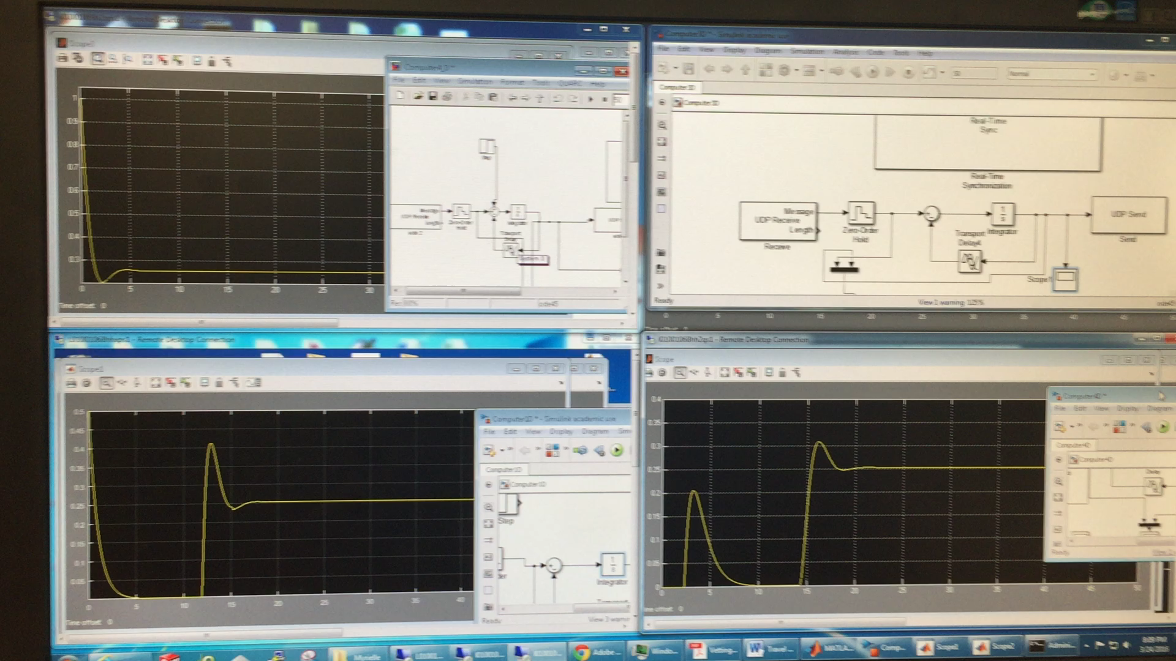
Experiment Run
D

Slide 24
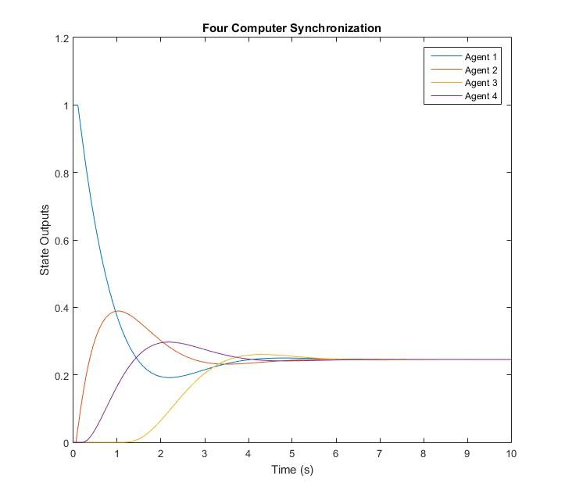
Response
Stable and synchronized

Slide 25
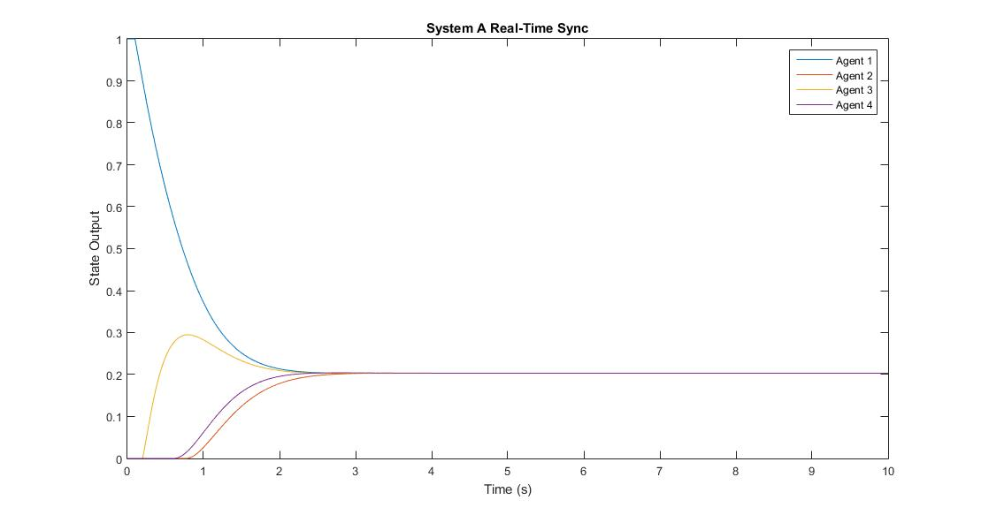
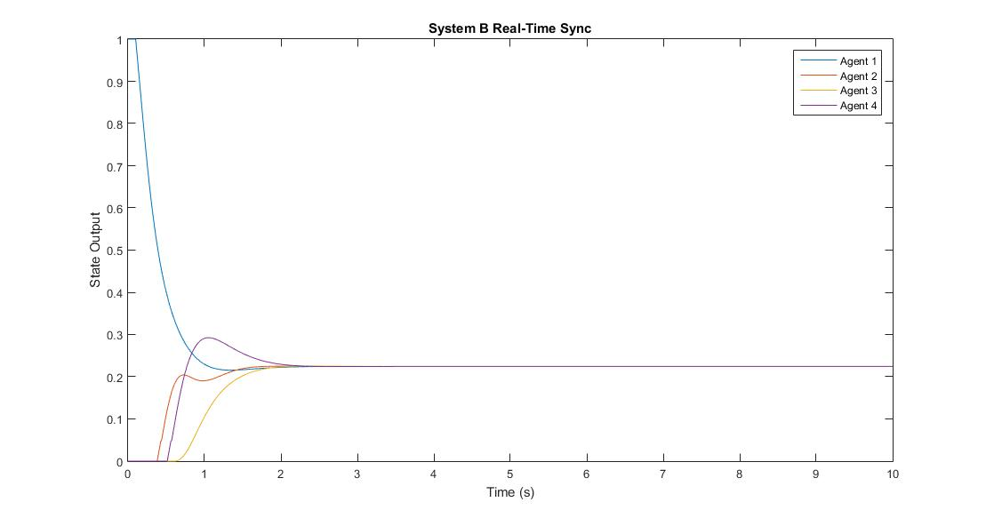
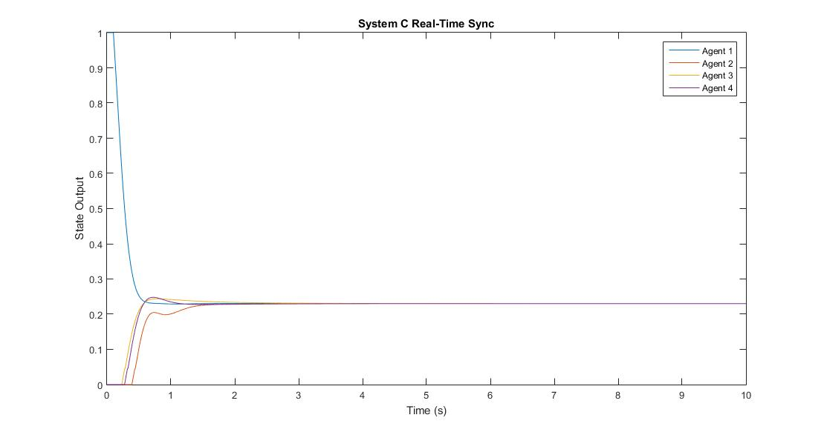
Responses of other topologies

Slide 26
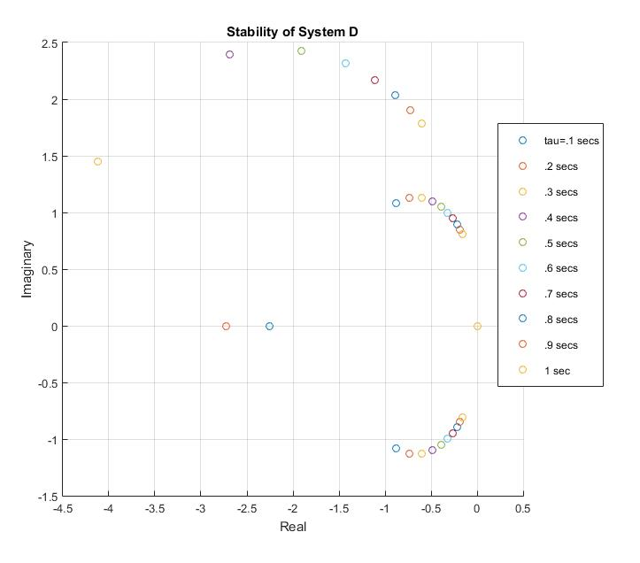
Eigenvalues
Rightmost eigenvalues* for topology [*Shinozaki,2007 & Yi et.al, 2007]

Slide 27
Eigenvalues
 | Experimental Roots | Numerical Roots
Delay | .1 seconds | .1 seconds
λ₁ | -0.0000 + 0.0000i | -0.0000 - 0.0000i
λ₂ | -0.8817 - 1.0857i | -0.9575 - 1.2269i
λ₃ | -0.8817 + 1.0857i | -0.9575 + 1.2269i
λ₄ | -2.2527 + 0.0000i | -2.5917 + 0.0000i
Rightmost eigenvalues for topology with .1 second delay

Slide 28
Summary
Successfully analyzed the stability
Performed sensitivity analysis of multiple topologies w.r.t delay
Better approach than previous work
Quantifies stability
Examine sensitivity
Examine and quantify convergence speed
Built testbed for networks of real-systems
Notes:
The convergence speed can be determined by the time constant which is the inverse of the eigenvalue. The smaller(more left) the eigenvalue, the faster the response

Slide 29
Future Work
Use the rightmost eigenvalue as a key point for eigenvalue assignment or pole placement within a control loop to ensure the system remains stable while switching topology.
Testbed can be implemented on systems such as drones, dc motors, and ground robots

Slide 30
References
Olfati-Saber, R. and R.M. Murray, Consensus problems in networks of agents with switching topology and time-delays. Automatic Control, IEEE Transactions on, 2004. 49(9): p. 1520-1533.
Crutchfield. Tamron AF28-300 Di VC lens -- one versatile zoom. [cited 2015 November].
SEMICON, F. Wireless Traffic Light Controller System. Available from: http://www.forbixindia.com/electronics/products/traffic-light-control/wireless-traffic-light-controller-system/.
Yi, S., Analysis and Control of Systems Considering Signal Transmission Delays, 2015.
Lin, P. and Y. Jia, Average consensus in networks of multi-agents with both switching topology and coupling time-delay. Physica A: Statistical Mechanics and its Applications, 2008. 387(1): p. 303-313.
Fax, J.A. and R.M. Murray, Information flow and cooperative control of vehicle formations. Automatic Control, IEEE Transactions on, 2004. 49(9): p. 1465-1476.
Olfati-Saber, R., A. Fax, and R.M. Murray, Consensus and cooperation in networked multi-agent systems. Proceedings of the IEEE, 2007. 95(1): p. 215-233.
Healey, A.J. Application of formation control for multi-vehicle robotic minesweeping. in Decision and Control, 2001. Proceedings of the 40th IEEE Conference on. 2001.
Bainum, P.M., A. Strong, and Z. Tan, Control of Formation Flying Satellites, 2000, DTIC Document.
Vadali, S., S. Vaddi, and K.T. Alfriend, An intelligent control concept for formation flying satellites. International Journal of Robust and Nonlinear Control, 2002. 12(2‐3): p. 97-115.
Wei, R., R.W. Beard, and E.M. Atkins. A survey of consensus problems in multi-agent coordination. in American Control Conference, 2005. Proceedings of the 2005. 2005.
Lin, J., A.S. Morse, and B.D.O. Anderson. The multi-agent rendezvous problem. in Decision and Control, 2003. Proceedings. 42nd IEEE Conference on. 2003.
Olfati-Saber, R., Flocking for multi-agent dynamic systems: algorithms and theory. IEEE Transactions on Automatic Control, 2006. 51(3): p. 401-420.
Huayi, L., et al. Relative Attitude Control in Satellite Formation Flying with Information Delay. in Intelligent Control and Automation, 2006. WCICA 2006. The Sixth World Congress on. 2006.
Richard, J.-P., Time-delay systems: an overview of some recent advances and open problems. Automatica, 2003. 39(10): p. 1667-1694.
Asl, F.M. and A.G. Ulsoy, Analysis of a system of linear delay differential equations. Journal of Dynamic Systems, Measurement, and Control, 2003. 125(2): p. 215-223.
Shinozaki, H., Lambert w function approach to stability and stabilization problems for linear time-delay systems. Kyoto Institute of Technology, Thesis, 2007.
Yi, S., P. Nelson, and A. Ulsoy, Delay differential equations via the matrix Lambert W function and bifurcation analysis: application to machine tool chatter. Mathematical Biosciences and Engineering, 2007. 4(2): p. 355.
Yi, S., Time-delay systems: analysis and control using the Lambert W function. 2010: World Scientific.
Stewart, S., A New Elementary Function for Our Curricula? Australian Senior Mathematics Journal, 2005. 19(2): p. 8-26.
Dence, T.P., A brief look into the Lambert W function. Applied Mathematics, 2013. 4(06): p. 887.
Erneux, T., Applied delay differential equations. Vol. 3. 2009: Springer Science & Business Media.

Slide 31
QUESTIONS

